Slide 1
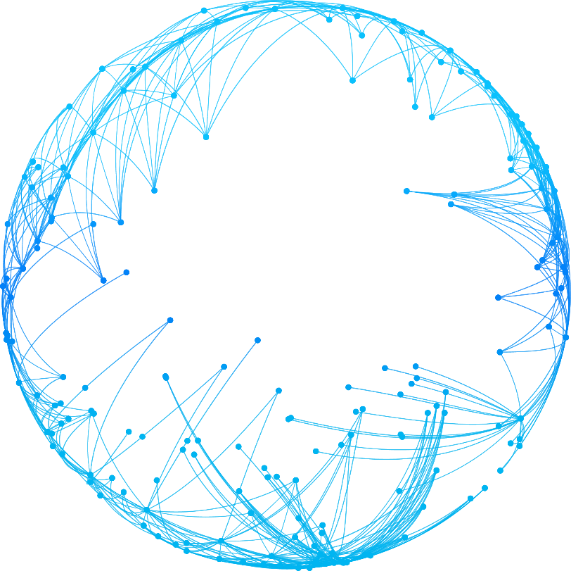

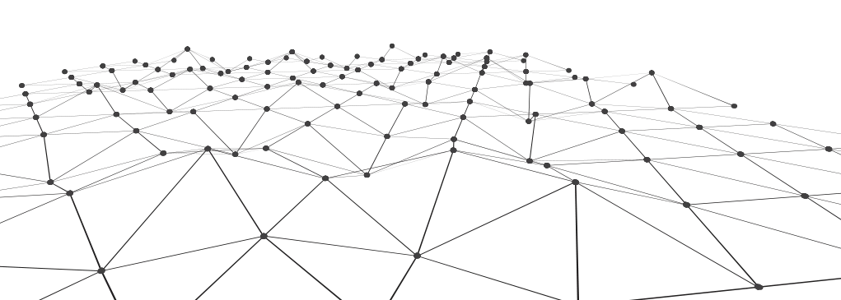

OgunCAD
Online 3D editor for designing decorative and artistic metal products.

Slide 2
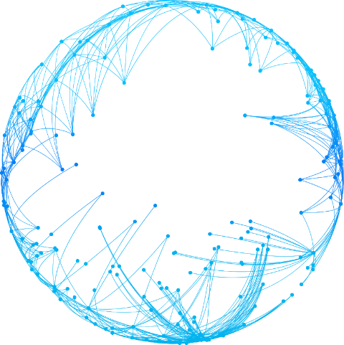
1
Idea:
How did OgunCAD appear?

Slide 3
Idea
The development of similar projects was carried out more than once :
American company
King Architectural Metals
Italian company Arteffero
The main problem that prevented these projects from being brought to their logical conclusion lay in the fact that the development was carried out for the enterprises themselves, for specific equipment and business processes, for the organizations themselves - that is, they were not unified to the broad standards of the entire industry.
OgunCAD
The approach from the particular to the general did not work ...

Slide 4
2
Goal:
To provide a previously unattainable level of automation in the production of steel structures.

Slide 5
Goal
On the way:
Modern ways of presenting designs according to standardized templates
Convenient design
Sales, accounting of designed structures, their publication.
Automatic calculation of technical and financial data

Slide 6
3
Customers:
Representatives of the decorative metal industry

Slide 7
The target audience
Paint manufacturers will be interested if the correct calculation of paint for the structure will be exactly their production listed in the catalog of materials OgunCAD
German company Hebo http://haboe.de/en/boehl-group.html
American company
King Architectural Metals
https://www.kingmetals.com
Turkish company Ostas http://en.ostas.com.tr/
Italian company Arteffero* https://store.arteferro.com/en/company/filiali/
* Arteferro had two unsuccessful attempts to create its CAD program "Arteferro CAD" and after a short time "Arteferro web". I have watched the development of both versions and understand their failures and also that they will potentially want to buy us outright or at least work closely together.
Suppliers of consumables for welding and other equipment.

Slide 8
The target audience
There are many machine tool builders and we are interested in cooperation with everyone, especially in the field of CNC for deeper integration with OgunCAD and increasing the level of production automation.

Slide 9
4
Algorithm :
End User Procedure

Slide 10
Algorithm:
After designing a structure in a 3D editor with a set of special and unique tools, the program will automatically prepare a technological chart for welding work and assign a part number. Same part - same number.
01
1
03
02

Slide 11
Algorithm:
For blacksmithing, the program automatically generates a technological map for blacksmiths. The part numbers correspond to the part numbers of the welding work, their quantity, the required length of the workpiece, and also describe all the operations that need to be performed with the workpiece in order to obtain a finished element for welding work.
01
2
03
02

Slide 12
Algorithm:
01
Further, in a couple of simple clicks, the program will display a list and weight of necessary materials, and the weight of the finished structure. For a client who is waiting for a commercial offer, there is a ready-made form, a couple of clicks and the report is ready. Who else can make such an offer so quickly and beautifully!? - The company's sales ratio is growing - what else is needed?*
3
03
02
* And you need not be mistaken with the announced price, the program calculates the cost of the product based on the cost of materials, waste, production time / wages of the main production workers, taxes and profits. The built-in tool is flexible and allows you to implement any other pricing schemes for a particular enterprise.

Slide 13
5
Possibilities:
This technology can do more than even we can imagine!

Slide 14
Possibilities:
What’s possible with OgunCAD?
The fastest performance of the entire system
Intuitive interface
Enormous savings in employee hours
Visually friendly design

Slide 15
Possibilities:
Commercial documents for the client.
End-to-end calculation of all materials for manufacturing.
Technological map of products.
Blank drawings.
Purchase requisitions for supply
And it's all in one click of the designer!

Slide 16
6
Present:
We have already outperformed the competitors!

Slide 17
Present
79 vendors have already paid for these features. These functions are completely superior to the "main" competitor FabCAD. After the release of OgunCAD, the guys will have to close down, because it will be multilingual and have much more features compared to Kovka 3D, you can’t even compare it with FabCAD.

Slide 18
7
Customers:
Who wants this?

Slide 19
Customers:
All manufacturers operating in the decorative metal industry:
to
Giants of the industry in thousands of people
from
Blacksmith workshop, with one blacksmith

Slide 20
Customers:
Who is useful OgunCAD?
End-to-end analytics from our materials catalog will be useful for supplying organizations:
Metal processing consumables: drills, cutters, hand tools.
Decorative coatings: paints, primers.
Consumables and equipment for welding.

Slide 21

This is the little we can show in this short presentation.
OgunCAD
To describe all the features and pros,it won't take one day.But it's easier to hear real testimonials from dozens of our satisfied customers, including:

Slide 22
OgunCAD
– our plans for 3 years.
3 000
495 USD
We expect 3,000 subscribers from the English-speaking audience by 495 USD per month.
Of which 500 during the calendar year.

Slide 23
OgunCAD
Online 3D Editor - setting the standard
Simplicity
Convenience
Effectiveness

Slide 24
OgunCAD

